Slide 1















Slide 3




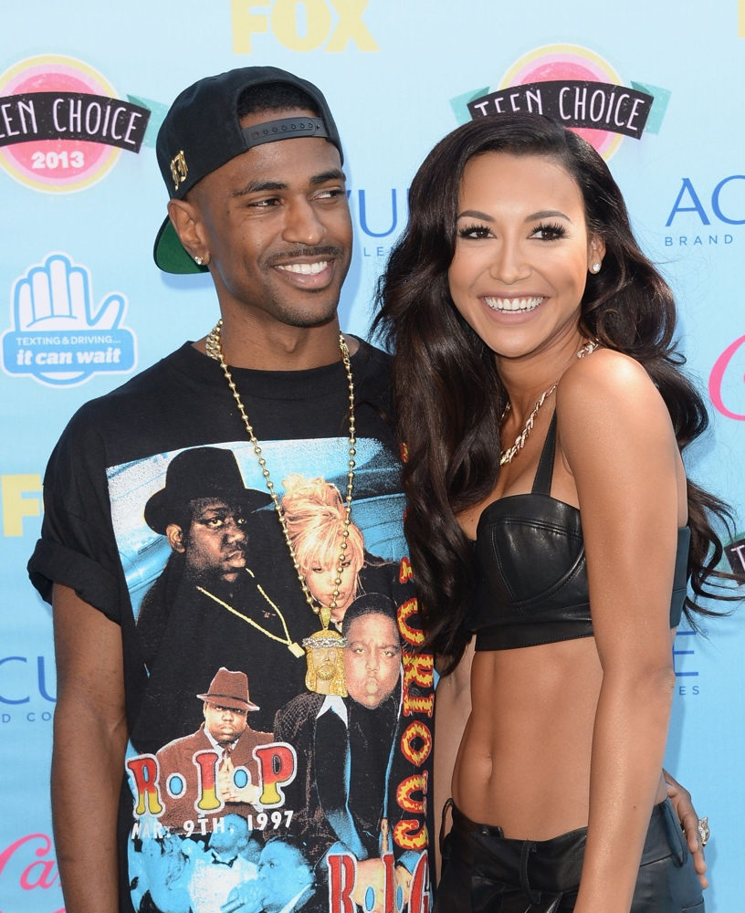



















I SEE IT
I LIKE IT
I WANT IT
I GOT IT
SEAN
SMARIANA SCHMANDE
“BREAKUP WITH YOUR GIRLFRIEND …CAUSE I’M BORED”

Slide 4



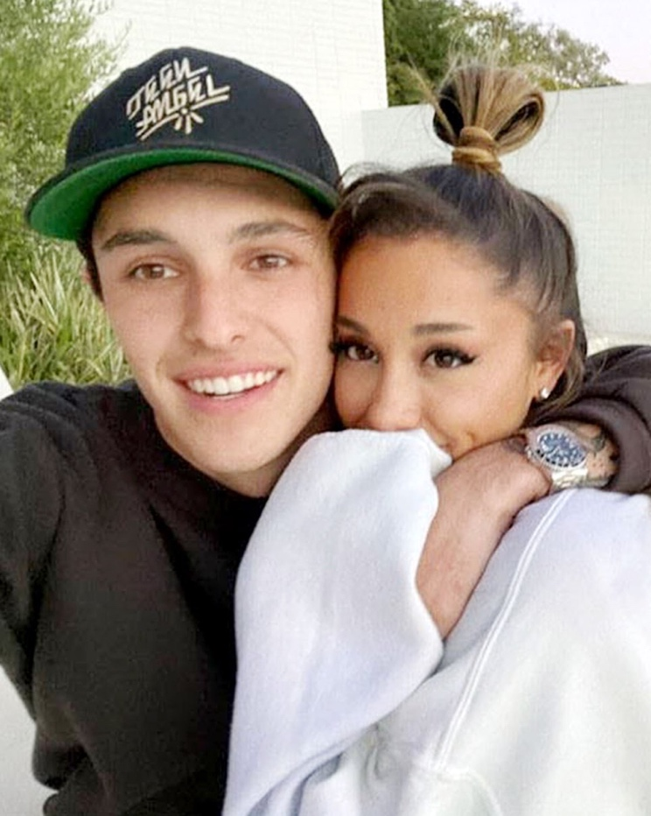


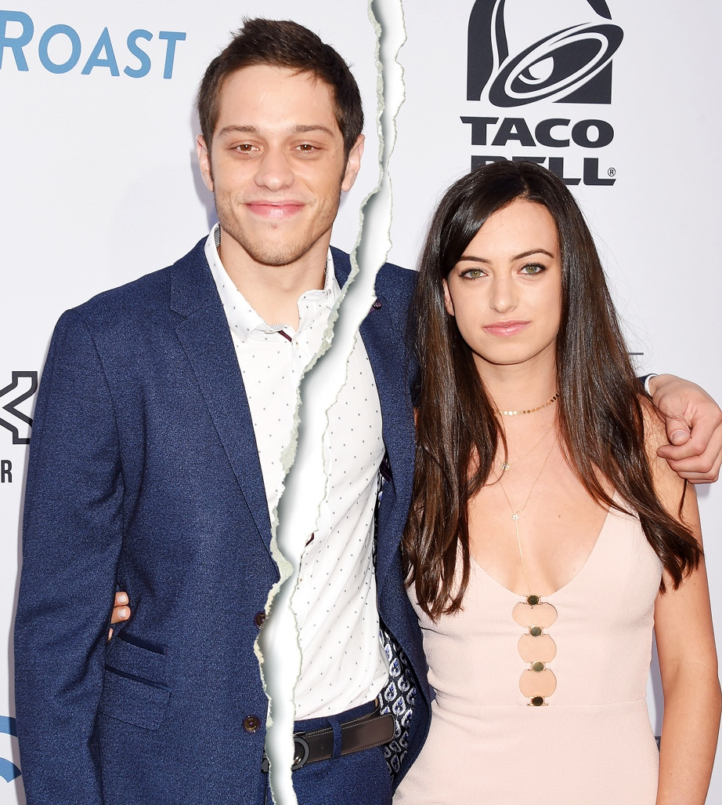

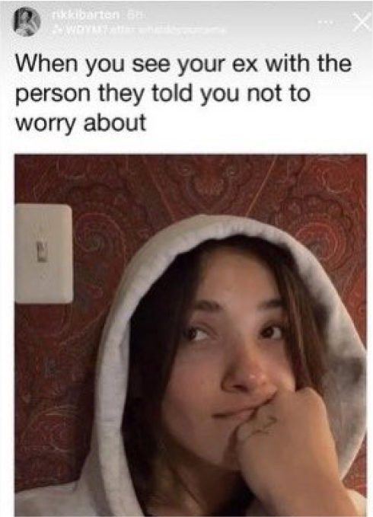


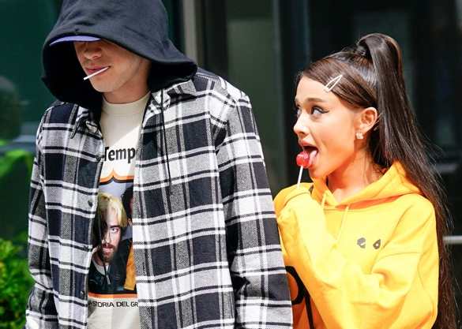









PETE
DIVORCED
2023
DALTON

Slide 5

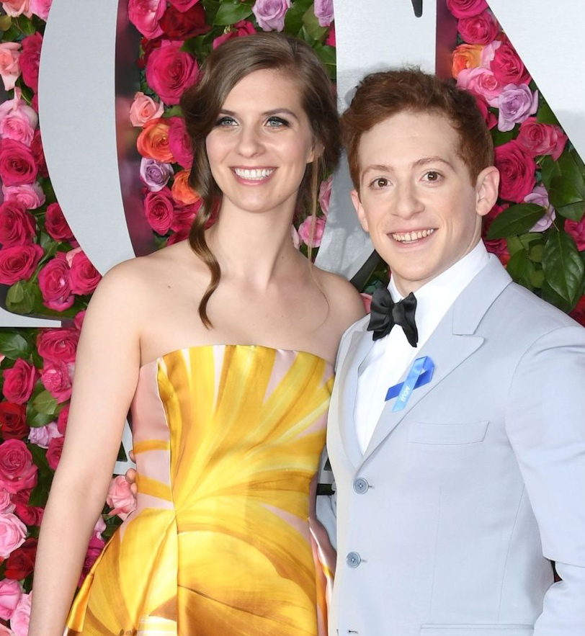











15 YEAR RELATIONSHIP
HIGH SCHOOL SWEETHEARTS
ETHAN
7 MONTH BABY
SLATER
CO-STARRING IN WICKED
SEPARATED 2 MONTHS BEFORE DATING ARIANA???

Slide 6

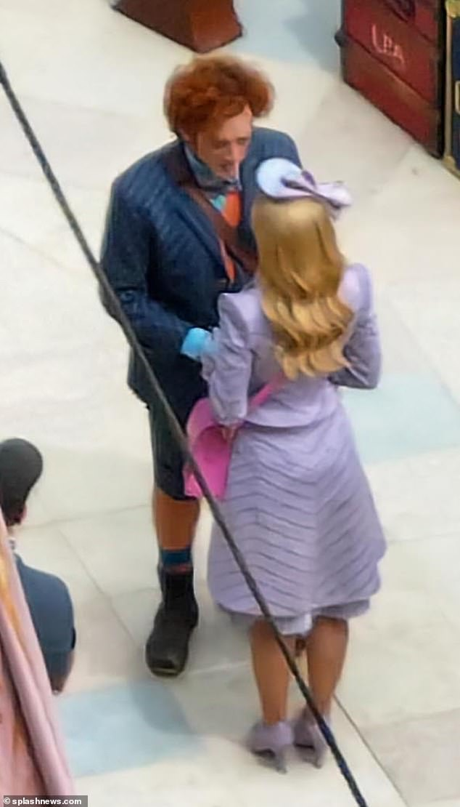
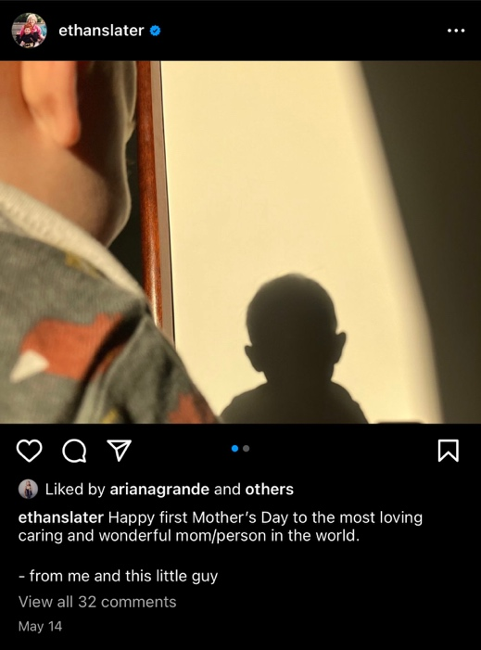

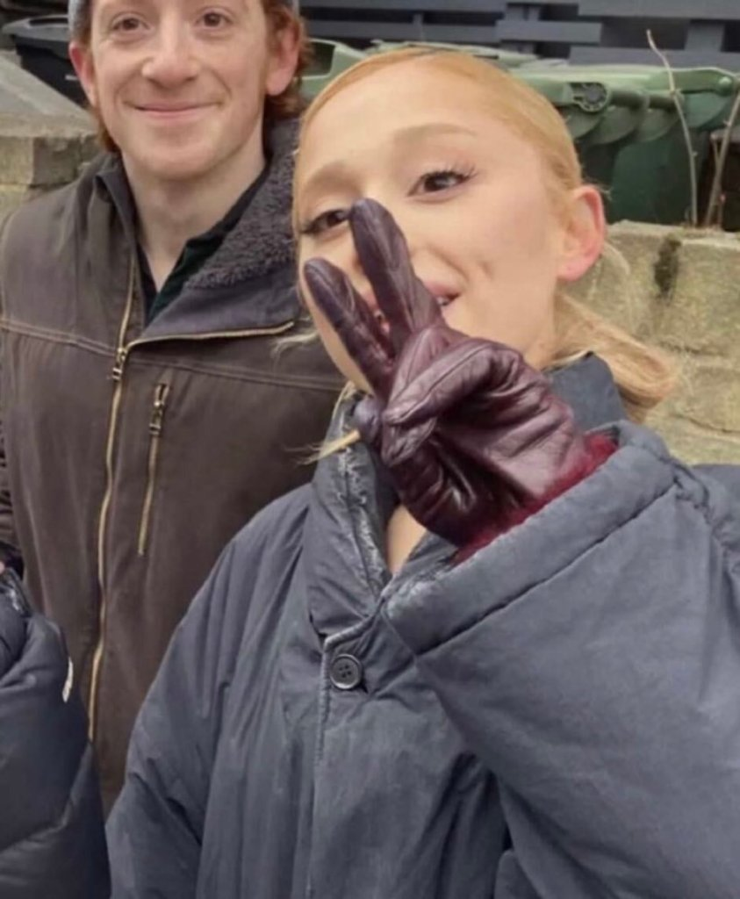

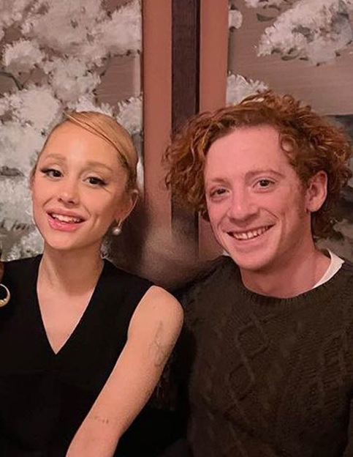





WHY DID SHE LIKE HIS MOTHERS DAY POST???
“SHE WANTED TO HAVE A BABY AND COULDN’T WAIT TO START A FAMILY”
MULTIPLE DOUBLE DATES WITH THEIR SPOUSES??
GIVING ETHAN SPACE RIGHT
NOW
SHE HAD DINNER WITH THEM & HELD THEIR BABY
“NOT A GIRL’S GIRL”

Slide 7
